Slide 1
Breaching privacy: memory scraping attacks on Xilinx fpgas
Bharadwaj Madabhushi, Sandip Kundu, Daniel Holcomb
University of Massachusetts Amherst

Slide 2
Overview
Motivation
Adversary Model
Attack Methodology
Experimental Setup
Results

Slide 3
Motivation: FPGA as Hardware Accelerator
FPGAs are becoming popular because they are,
Hardware and Software scalable (reconfigurable)
Competitive performance [1]
Energy efficient [1]
Low cost and small Form factor
More density of computing per unit volume
Large number of LUTs
Efficient utilization of resources
Accelerate parallel computing
FPGAs are in Host-based systems
Microsoft Project Brainwave
IBM – neural network modelling
AWS, Alibaba, Baidu – “FPGA-as-a-service” or “Acceleration-as-a-service” [2]
Figures adapted from [1].
[1] J. Carabaño, F. Dios, M. Daneshtalab and M. Ebrahimi, "An exploration of heterogeneous systems," 2013 8th International Workshop on Reconfigurable and Communication-Centric Systems-on-Chip (ReCoSoC), Darmstadt, Germany, 2013, pp. 1-7, doi: 10.1109/ReCoSoC.2013.6581542.
[2] N. Pundir, F. Rahman, F. Farahmandi, and M. Tehranipoor, “What is all the faas about?-remote exploitation of fpga-as-a-service platforms,” Cryptology ePrint Archive, 2021.
Notes:
Reprogrammable: FPGAs can be reconfigured in the field, enabling updates and improvements without hardware replacement.This is especially beneficial in remote or hard-to-reach locations. FPGAs can be programmed and reprogrammed to perform a wide range of tasks, making them adaptable to changing requirements.
Users can create custom hardware circuits tailored to specific applications.
Comparable performance: Explain 1, 2 paper’s results.
Energy efficiency: 1’s results.
Talk about GPU dissipating heat , needs cooling systems and larger form factor.
FGPA power dissipiation is smaller.
More density of computing per unit volume
Environmental aspect on more power consumption in GPU.

Slide 4
Multi-tenancy in FPGAs
Large number of resources
Logic resources – Slices, Logic cells, CLB Flip flops
(AMD’s Ultrascale + Virtex 7 family has around 100K slices, 500k logic cells and 500K CLB FFs in a single FPGA)
Memory resources – DRAM, Block-RAM, Ultra-RAM, HBM, PLRAM
(AMD’s Alveo family has around 32GB DRAM, 16 GB HBM)
Partial reconfiguration
Configure a portion/region within the programmable logics (PLs)
More efficient resource utilization
AMD offers Partial reconfiguration as DFX
Hard-coded IPs (Accelerators within Accelerator)
AES engines, Memory controllers, etc.
“Embedded Processing system” to handle multi tenancy
Embedded processor and Embedded OS
Resource allocation and management
Picture courtesy: https://www.istockphoto.com/illustrations/apartment-tenant
Notes:
Reprogrammable: FPGAs can be reconfigured in the field, enabling updates and improvements without hardware replacement.This is especially beneficial in remote or hard-to-reach locations. FPGAs can be programmed and reprogrammed to perform a wide range of tasks, making them adaptable to changing requirements.
Users can create custom hardware circuits tailored to specific applications.
Comparable performance: Explain 1, 2 paper’s results.
Energy efficiency: 1’s results.
Talk about GPU dissipating heat , needs cooling systems and larger form factor.
FGPA power dissipiation is smaller.
More density of computing per unit volume
Environmental aspect on more power consumption in GPU.

Slide 5
How FPGA connects to a Host system (Cloud) ?
Host-based system
Dave
Host OS control
Embedded OS control
Dave’s VM
Dave’s
app
Eve’s
app
Carol’s
app
Eve’s VM
PL
PL
PL
Embedded Processor (PS)
Eve
Host
Processor
PCIE
Carol’s VM
Dave’s
data
Eve’s
data
Carol’s
data
Host DRAM
Host
Zynq Ultrascale+ MPSoC (FPGA)
Carol
There are security challenges!
Notes:
Reprogrammable: FPGAs can be reconfigured in the field, enabling updates and improvements without hardware replacement.This is especially beneficial in remote or hard-to-reach locations. FPGAs can be programmed and reprogrammed to perform a wide range of tasks, making them adaptable to changing requirements.
Users can create custom hardware circuits tailored to specific applications.
Comparable performance: Explain 1, 2 paper’s results.
Energy efficiency: 1’s results.
Talk about GPU dissipating heat , needs cooling systems and larger form factor.
FGPA power dissipiation is smaller.
More density of computing per unit volume
Environmental aspect on more power consumption in GPU.

Slide 6
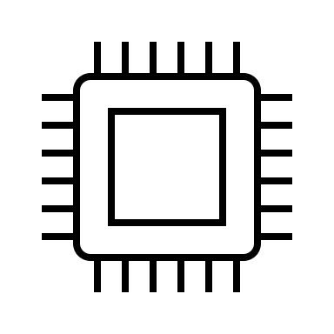
Security Question ?
FPGA
Butterfly
Bob
Read Data
Local Memory
Hardware Accelerator
Host-based system
Oscar
Is the FPGA’s local memory cleared after the host’s offloaded task completes?
If it isn’t cleared, can the contents of the previous task be accessible from the FPGA’s local memory?
Notes:
Explain the questions clearly.
Host-based system handle confidential, sensitive and critical data of a user.
Banking, Automotive industry, Data Analytics.
Use DNNs.
Attack Hypothesis
The FPGA uses this data for computation when the user’s task is offloaded.
Results are stored in the FPGA’s memory before writing to Host’s memory.
Uncleared local memory risks unauthorized data access and security compromise by a subsequent offloaded user.

Slide 7
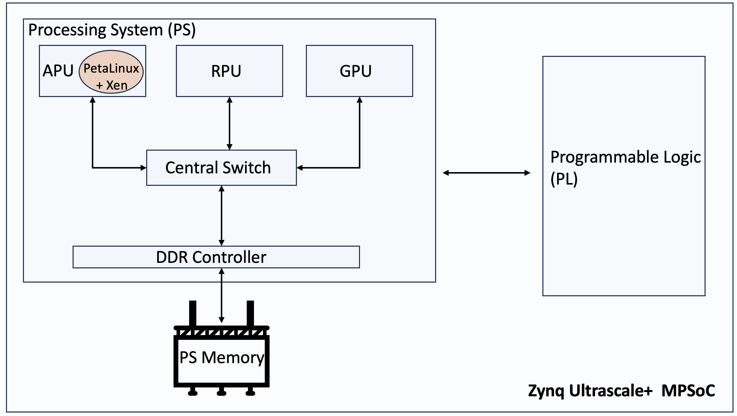
About ZCU104
To investigate we chose the AMD’s (Xilinx) Zynq Ultrascale+ MPSoC ZCU104 board
Why AMD’s FPGA?
Major cloud service providers like
AWS, Alibaba, Baidu use AMD’s FPGAs [1], [2] and [3]
Use Ultrascale+ family FPGAs [4]
Why Zynq Ultrascale+ MPSOC ZCU104?
Affordable
Part of Ultrascale+ family [5]
Operates PetaLinux embedded OS
About ZCU104 board [6]
ARM Cortex-A53
Application Processing Unit (APU)
Dual-core Cortex-R5
Real Time Processing Unit (RPU)
Mali-400 MP2 GPU
4GB DRAM
XPMU (Xilinx Memory Protection Unit)
XMPU
ZCU104 Overview
[1] https://aws.amazon.com/ec2/instance-types/f1/
[2] https://www.amd.com/content/dam/amd/en/documents/resources/case-studies/alibaba-case-study.pdf
[3] https://www.datacenterdynamics.com/en/news/baidu-to-use-xilinx-fpgas-in-its-data-centers/
[4] https://www.xilinx.com/products/silicon-devices/fpga/virtex-ultrascale-plus.html
[5] https://docs.xilinx.com/v/u/en-US/ds890-ultrascale-overview
[6] https://www.xilinx.com/products/boards-and-kits/zcu104.html
Notes:
The ZCU104 has an architectural design similar to other Ultrascale+ FPGAs, making our attack scenario credible and relevant.
Explain about zcu104 internals and petalinux in detail.
Mention in why petalinux: Host OS communicates with FPGA via Petalinux OS ,it helps in data transfer b/w host and FPGA hnablded by Petalinux over PCIe.
Increase

Slide 8
PetaLinux and XMPU
Dave
Eve
Carol
About PetaLinux [7]
Embedded Linux OS
Customizable
Boot Images
Vitis-AI tools
Runs on Zynq Ultrascale+ family
About XMPU (Xilinx Memory Protection Unit)
Isolation of memory
Partition user defined regions in memory
Prevent unauthorized access (when the victim is alive) – ID based check
Hardware logic is in memory controller IP
We demonstrate PetaLinux (software) and XMPU (hardware) lack the ability to initialize memory after a user terminates
XMPU (in memory controller)
Dave’s Address space
Eve’s Address space
Carol’s Address space
DRAM
[1] https://support.xilinx.com/s/article/968413?language=en_US
[2] https://docs.amd.com/r/en-US/ug1137-zynq-ultrascale-mpsoc-swdev/Protecting-Memory-with-XMPU
Notes:
The ZCU104 has an architectural design similar to other Ultrascale+ FPGAs, making our attack scenario credible and relevant.
Explain about zcu104 internals and petalinux in detail.
Mention in why petalinux: Host OS communicates with FPGA via Petalinux OS ,it helps in data transfer b/w host and FPGA hnablded by Petalinux over PCIe.
Increase

Slide 9
Adversary model
Goals
Retrieve data from memory of a terminated process
Analyze data to extract critical information of the terminated process
Thus, compromise privacy and security of a previous process
Capabilities
Offline profiling:
Access to ZCU104 board
Can access pids, pagetables, to understand physical memory layout of an application
Record local memory layout for common applications
Use of system debugger (XSDB)
Privileged access
Attack:
Log in as a guest
Track any application of interest
Gather that application’s process details
Leverage offline profiling knowledge to locate critical data in physical memory
Note: We assume that the ZCU104 board is utilized for running machine learning models (applications)
Notes:
The ZCU104 has an architectural design similar to other Ultrascale+ FPGAs, making our attack scenario credible and relevant.
Explain about zcu104 internals and petalinux in detail.
Mention in why petalinux: Host OS communicates with FPGA via Petalinux OS ,it helps in data transfer b/w host and FPGA hnablded by Petalinux over PCIe.
Increase

Slide 10
Attack Methodology
Adversary follows 4 steps
Step 1. Polling for pid: “ps-ef”
Step 2.Enable debugger: Retrieve virtual addresses and convert to physical address: ”heap” (maps file)
Step 3. Data extraction from physical addresses: “devmem <physical_address>”
Step 4. Analysis of extracted data:
Step 4.a. Identify models from strings: “xxd” hexdump.
(“resnet50”, “resnet50_pt”, .. “squeezenet”)
Step 4.b. Identify image: Based on offline profiling knowledge, determine the image’s location.
Notes:
Explain in detail: All the steps

Slide 11
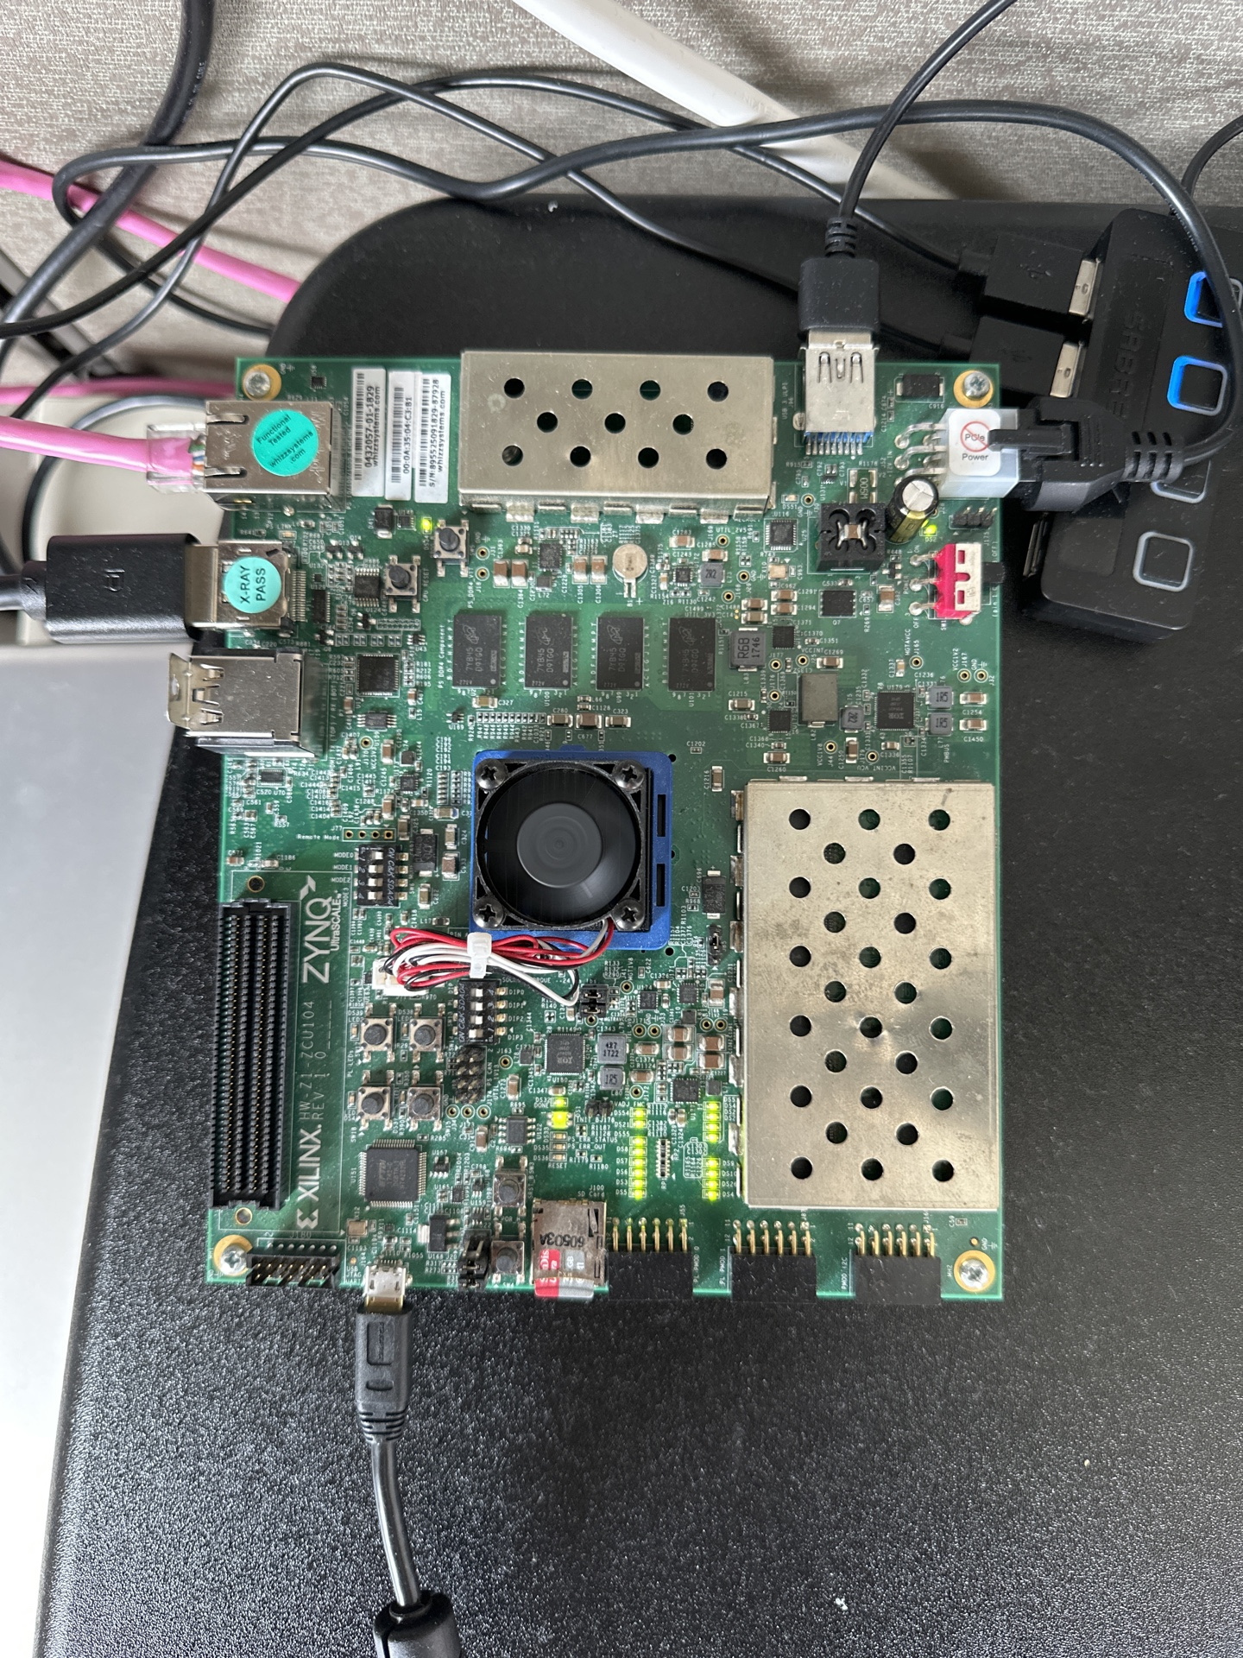
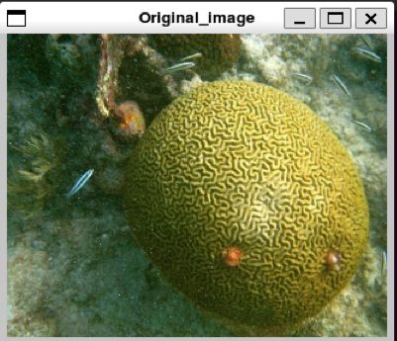
Experimental Setup
Setting up ZCU104 [1]
Flash Petalinux image (XMPU enabled) onto SD card and boot
Install Vitis-AI to run ML models
Victim Model
Chose “resnet50_pt” (RESidual NETwork using PyTorch Framework)
Widely used model for image recognition
Staining Image
Stain AMD-provided resnet50_pt input image (“FFFF FFFF”)
Reason for staining:
Serves as an identifier for the image when read from FPGA memory
Implement steps described in Attack methodology
Two terminals: Victim and Attacker
Victim runs “resnet50_pt”
Attacker runs the steps from the Attack methodology
ZCU104 picture
Original Image
Stained Image
Notes:
Explain experimental setup in detail.

Slide 12
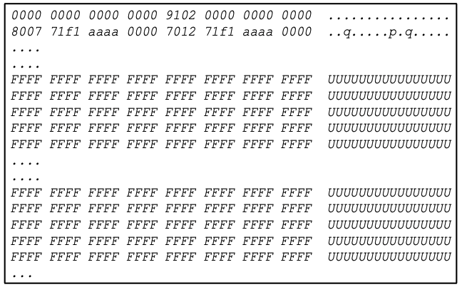
Results
Step 4.a:Analysis of extracted data
(Identifying models)
Step 4.b:Analysis of extracted data (Identifying Image)
Picture shows that the model “resnet50_pt” name is found in the readout from the FPGA memory (after hexdump xxd).
Figure shows occurrence of “FFFF FFFF” the identifier of corrupted image used as an input by the victim. Starts at “646768” row.
Notes:
Explain results: Step 4.b

Slide 13
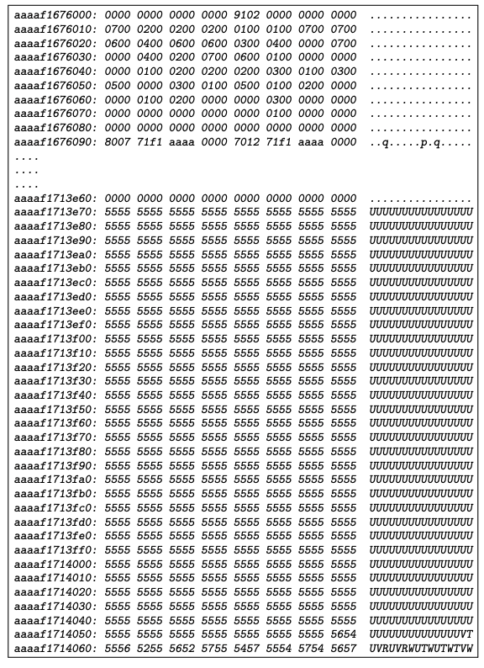
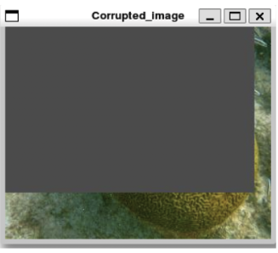
Results (contd …)
Step 4.b:Analysis of extracted data (Identifying Image)
(Using different identifier)
Corrupted Image used an input
Figure shows occurrence of “5555 5555” the identifier of corrupted image used as an input by the victim. Starts at “646768” row.
Notes:
Explain results: Step 4.b

Slide 14
Conclusion and Further Work
Conclusion
Host has no control over accelerator’s local memory
PetaLinux (embedded OS) limitations
Allows unrestricted access to process details
Does not initialize memory locations used by a terminated process
There is no randomization in physical page layout.
Allows attacker to learn process’s data offsets, simply by running the same program with own input data
XMPU limitations
Hardware feature to flush the local memory
Only provides protection when victim is alive
Further Work
Mitigation Strategies
Working on mitigation strategies (solution) to sanitize (clear or obfuscate) the contents in the memory locations of the local memory of FPGA.
Notes:
Explain results: Step 4.b

Slide 15
Ethical Disclosure
In line with responsible disclosure and ethical practices within the computer security research community, we promptly reported these findings to AMD/Xilinx on July 14, 2023, along with all relevant details. AMD, the parent company of Xilinx acknowledged the validity of the attack on August 23, 2023.
Notes:
Read out ethical disclosure.

Slide 16
Thank you!
QUESTIONS & ANSWERS

Slide 17
Backup Slides
Notes:
Read out ethical disclosure.

Slide 18
Results
Step 1. Polling for pids
Step 2. Retrieve virtual addresses (debugger) and convert to physical address
Process list before victim model was run.
Process list after victim model was run.
Allocated Virtual address range for the victim process.
Allocated physical address range for the victim process.
Notes:
Explain results. Step1 and 2

Slide 19
Results (contd …)
Step 3. Data extraction from physical addresses
Step 4.a:Analysis of extracted data (Identifying models)
Victim process is terminated (no PID1391).
Example of how “devmem” is utilized to read data.
Picture shows that the model “resnet50_pt” name is found in the readout from the FPGA memory (after hexdump xxd).
Notes:
Explain results: Step 3 and 4.a

