Slide 1
Protecting Sensors from Electromagnetic
Side-channel Leakage
Yan Long¹, (yanlong@umich.edu),
Qinhong Jiang², Chen Yan², Tobias Alam¹,
Xiaoyu Ji², Wenyuan Xu², Kevin Fu³
Based on [EM Eye: Characterizing Electromagnetic Side-channel Eavesdropping on Embedded Cameras, NDSS 2024]
¹ University of Michigan, EECS ² Zhejiang University, EE ³ Northeastern University, ECE & CS

Slide 2
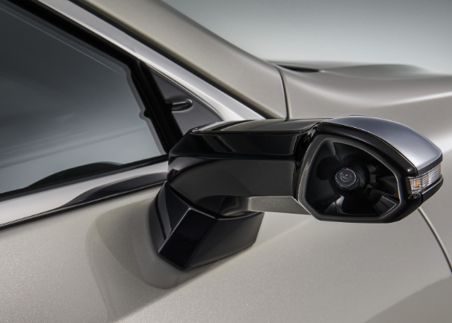
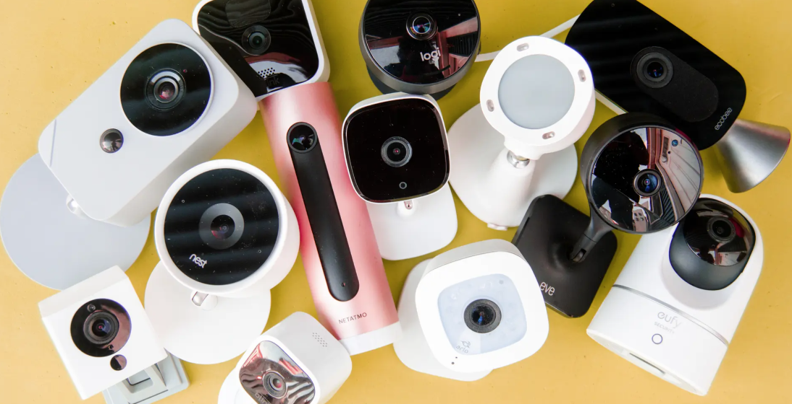
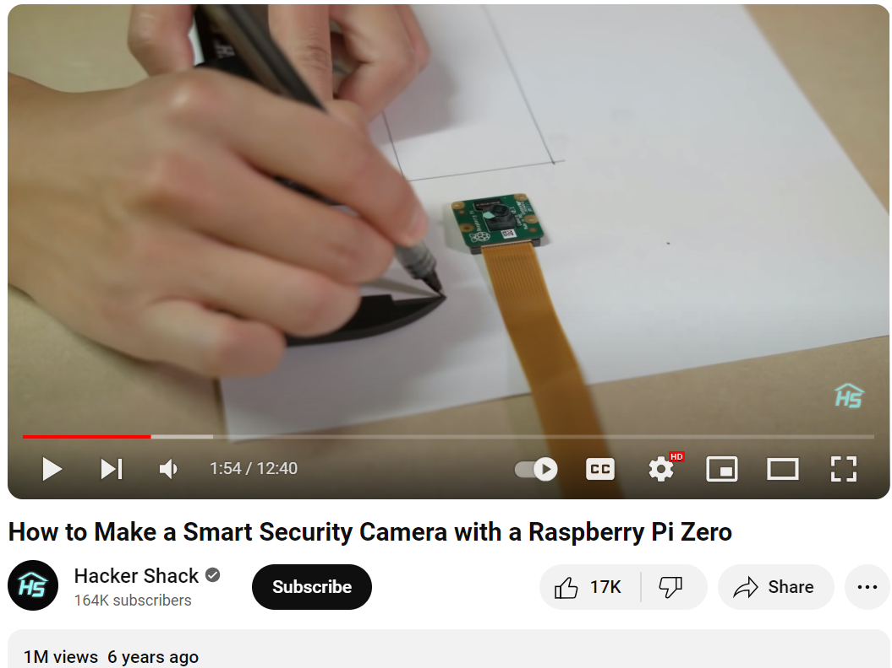
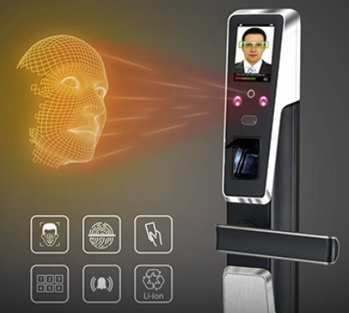
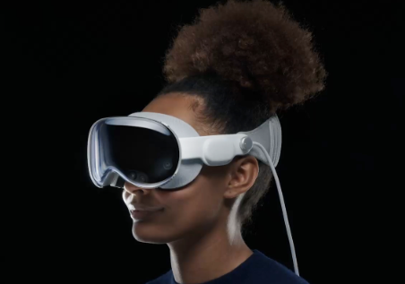
Cameras Getting Pervasive
[Photo: Car and Driver, NY TImes, Simpled, Apple]
Notes:
As shown in the title, in this talk I will explain the side-channel leakage risks in sensors.
And to provide a more concrete example, this talk will focus on a specific type of sensors, that is our cameras.
We know that today cameras sensors are widely embedded into various types of commercial electronics.
Even if we don’t directly purchase these camera devices, there are people on YouTube teaching us how to build IoT cameras using raspberry pi camera modules,
which I believe many of us here may have tried or want to try just for fun.
However, we are computer security researchers, and of course we are concerned about the security of our camera data.

Slide 3
Camera Data Confidentiality
Software Vulnerabilities
Hardware Vulnerabilities
Default Password & Unencrypted Comms [Abdalla et al., 2020]
?
Brute-force Attacks against 4-digit Passwords [Ling et al., 2017]
Known Serial Number Camera Hijacking [Herodotou et al., 2023]
Network Traffic Sniffing and Reconstruction [Tekeoglu et al., 2015]
Notes:
So software vulnerabilities and misconfigurations are probably the first thing that comes to mind.
For example, it is an old story that many IP cameras use default or very weak passwords which allow adversaries to hijack the cameras.
And as security researchers we surely know how to fix these problems by making some software patches or settings strong passwords.
But the new question we ask in this work is that, assuming all software and network components of a camera system are secured, how can the camera data still be leaked to attackers?
For example in the worst case for an attacker, what if it’s an air-gapped camera that records and stores data locally?
Our research shows there are still ways to spy on the camera data even in these cases, and the answer lies in the unexplored hardware vulnerabilities of modern camera systems.

Slide 4
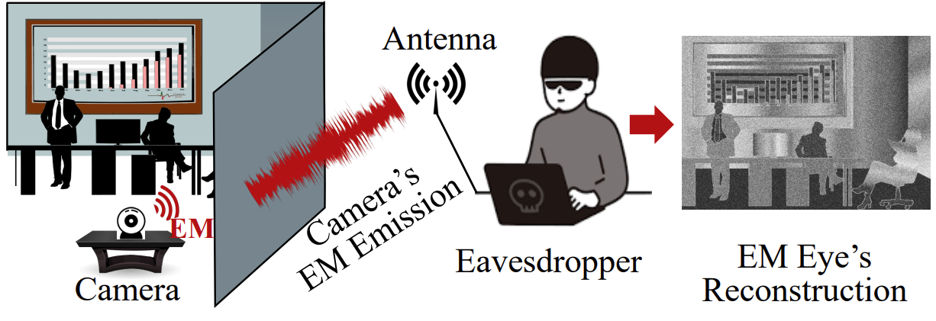
Threat Model: EM Eavesdropping on Cameras
No software/network entry point
External physical eavesdropper
Unintentional electromagnetic leakage (not wireless comm signals)
Notes:
Let me present the threat model first.
The adversary we investigate in this work is in the form of an external eavesdropper who can set up a physical eavesdropping equipment in the vicinity of the target camera.
And specifically, the eavesdropping equipment uses a radio frequency antenna to pick up the unintentional electromagnetic leakage from the target camera system, and then try to reconstruct the confidential camera videos by analyzing the electromagnetic signals in the environment.

Slide 5
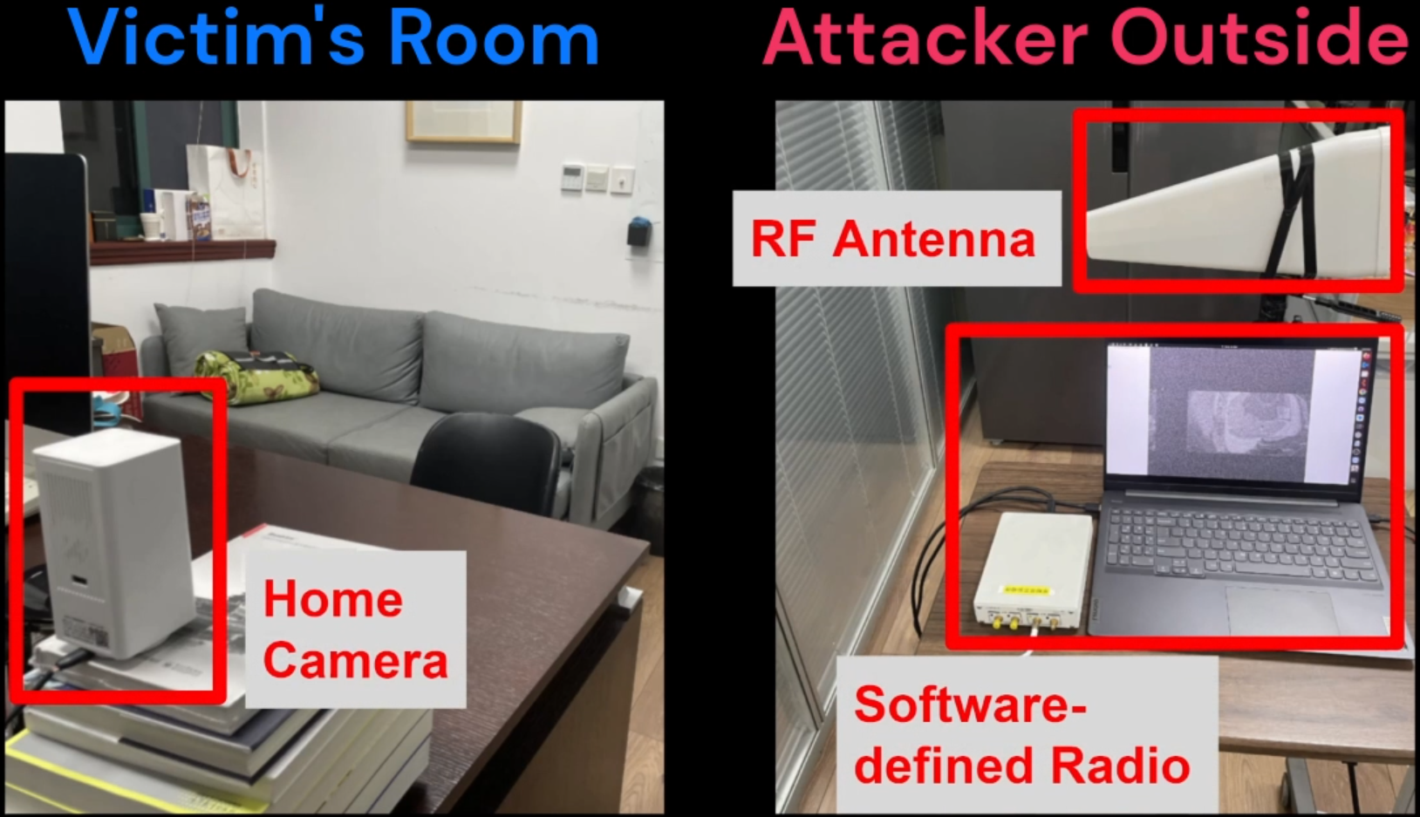
Threat Model: EM Eavesdropping on Cameras
Demo, tutorial, simulation:
https://emeyeattack.github.io/Website/
Notes:
Before explaining how it works, let me first explain what the eavesdropping attack looks like.
So for example, a victim has a camera in his room and he believes the camera video is only available to himself assuming all software access controls are secured. However, the adversary can set up an eavesdropping device with an antenna outside of his room to capture the EM leakage and reconstruct the room images in real time.

Slide 6
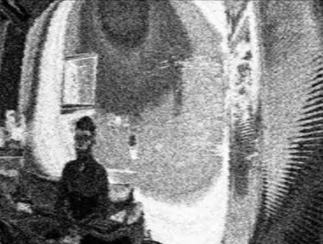
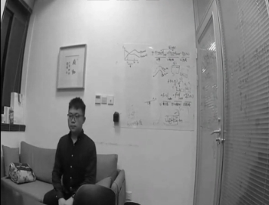
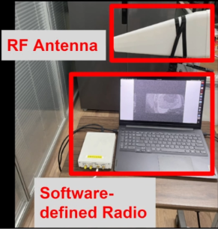
Image-specific Electromagnetic Leakage
Notes:
So how can the adversary actually achieve this? Let’s look at the abstraction of this problem.
Here we have a ground truth image taken by the camera, and the adversary reconstructs an image from the electromagnetic leakage from the cameras. The reconstruction process achieved by the eavesdropping equipment and algorithm is defined as the function R here.

Slide 7
Image-specific Electromagnetic Leakage
?
Notes:
So now as you can see the key task is to understand how the ground truth image captured by the camera is transformed into EM leakage signals.
And this is equivalent to understanding which component of the camera system generates such unintentional EM leakage.

Slide 8
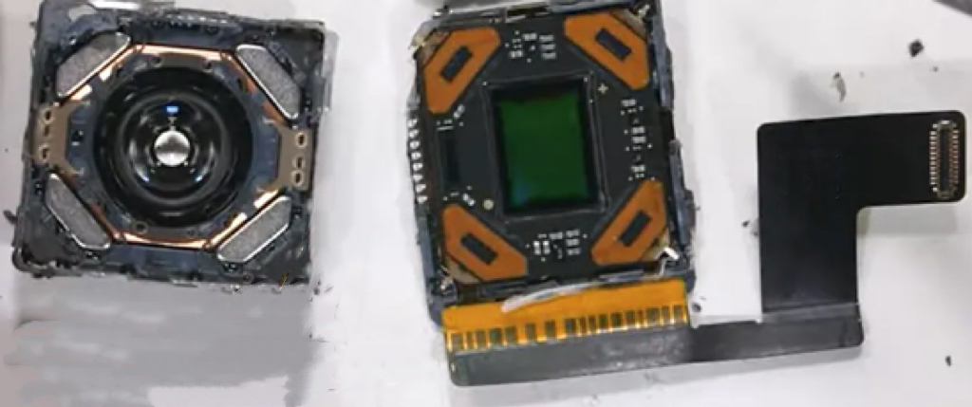
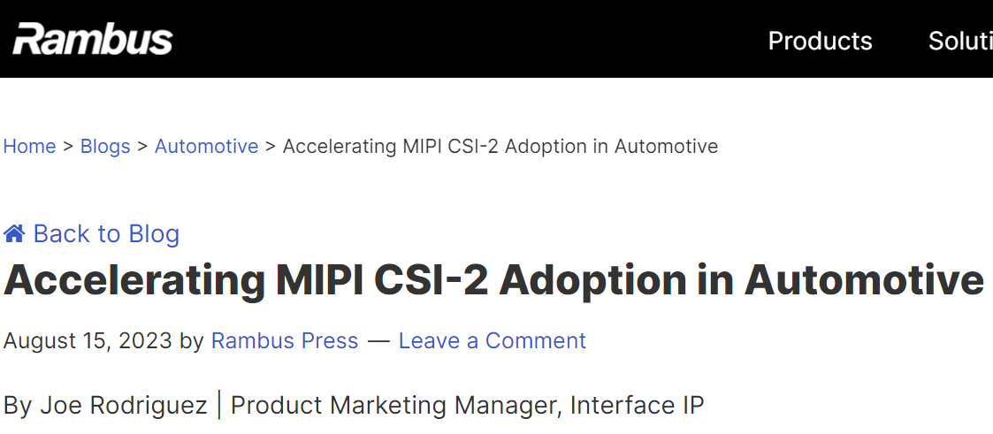
Interface: Standardization
Notes:
It is not an easy task. But through many experiments, we have identified the main source of leakage to be the image data transmission interface.
Specifically, we observe that there is a strong trend for embedded camera devices to adopt the same standard data transmission interface between the camera sensor and the downstream processors.
Someone might be wondering why the cameras use such data transmission interface? Now imagine that you are the CEO of a company that manufactures cars and you want to provide some built-in dash cams to your customers. Of course you are not going to manufacture the camera sensors by yourself. Instead, you get the sensors from companies like Sony and Samsung. As a result, you need a way to connect the camera sensors to the processors of your car. And this is where such image data transmission interface comes into play.

Slide 9
Interface: Serialized, Predictable Data Structure
2 frames
10 rows
Notes:
But here is a bad news. These standard interfaces transmit data in a completely unprotected manner.
To transmit a video which can be represented as an array of 2D matrices, the sensor would transmit the data frame by frame, row by row, and column and column, following a completely predictable order.
That is to say if someone can somehow eavesdrop on the transmitted data, they could then reconstruct the image captured by the camera.

Slide 10
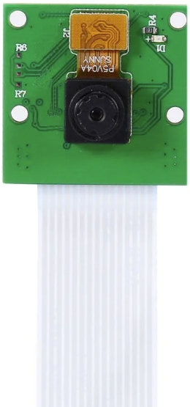
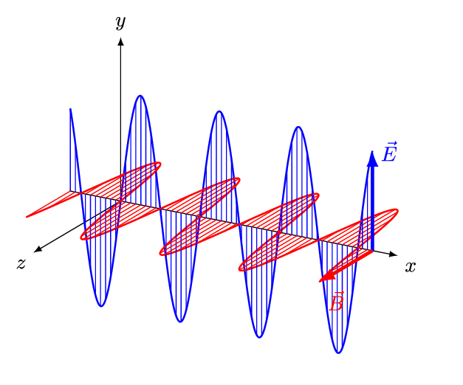
Unprotected Data & EM Emanation
Interface Protocol
Optic RAW Digital Electromagnetic
[Maxwell’s Equations]
Unintentional Sender
Adversary’s Receiver
Notes:
And in this attack I demonstrated, the adversary eavesdrops on the transmitted data by receiving and analyzing the unintentional electromagnetic leakage from the camera circuits.
The camera data interface transmits RAW image data encoded in digital bits according to the protocol of the transmission interface.
And digital bit flips are achieved by physical alternating currents in the transmission circuits, which produce an electromagnetic field according to the Maxwell’s equations that we all know.
The data cable then acts as an unintentional antenna that broadcasts the plain image data to the adversary.

Slide 11
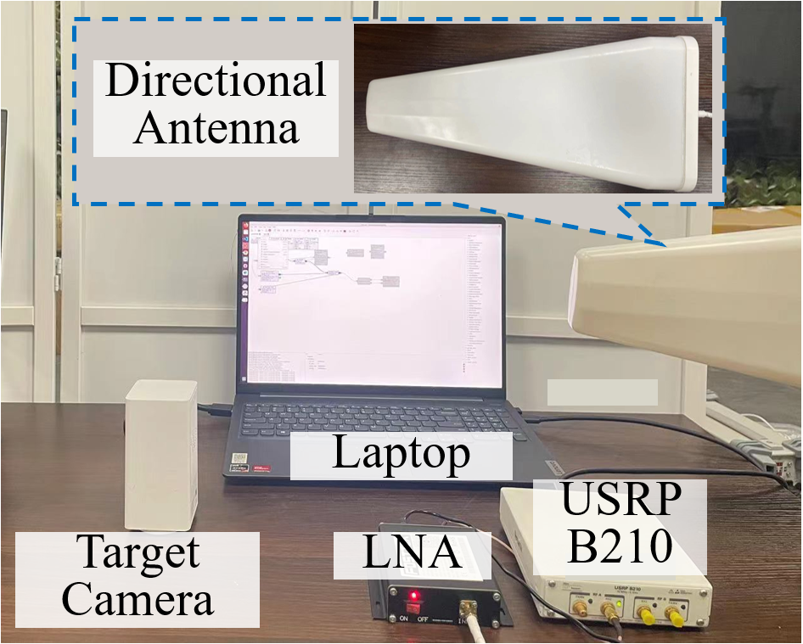
EM-image Correlations
Notes:
This figure on the right shows a very simple example, where a camera captures a black and white image, and the EM leakage is captured by the attacker’s antenna when the camera is transmitting the data of a specific row in the image. We can see that different brightness of the image causes different amplitudes of EM leakage signals.
And this eavesdropping methodology allows the attacker to bypass all software controls on the victim system because the image data has not even entered the software space yet.
Alright great, now we might be thinking, let’s put this together and reconstruct a complete image.
And the next question is how similar the reconstructions can be to the original camera captures.
And our experiments do show there are many unavoidable distortions in the reconstructions.

Slide 12
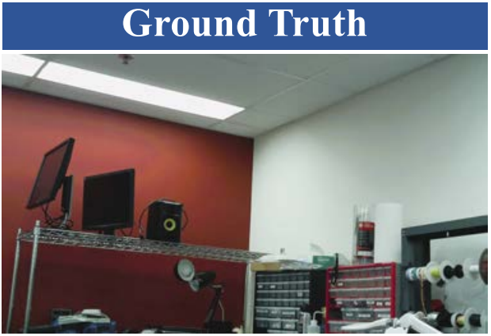
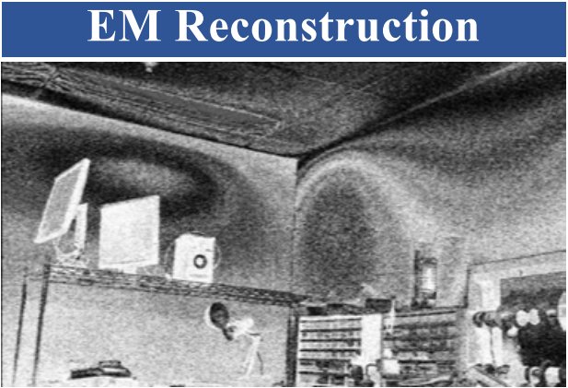
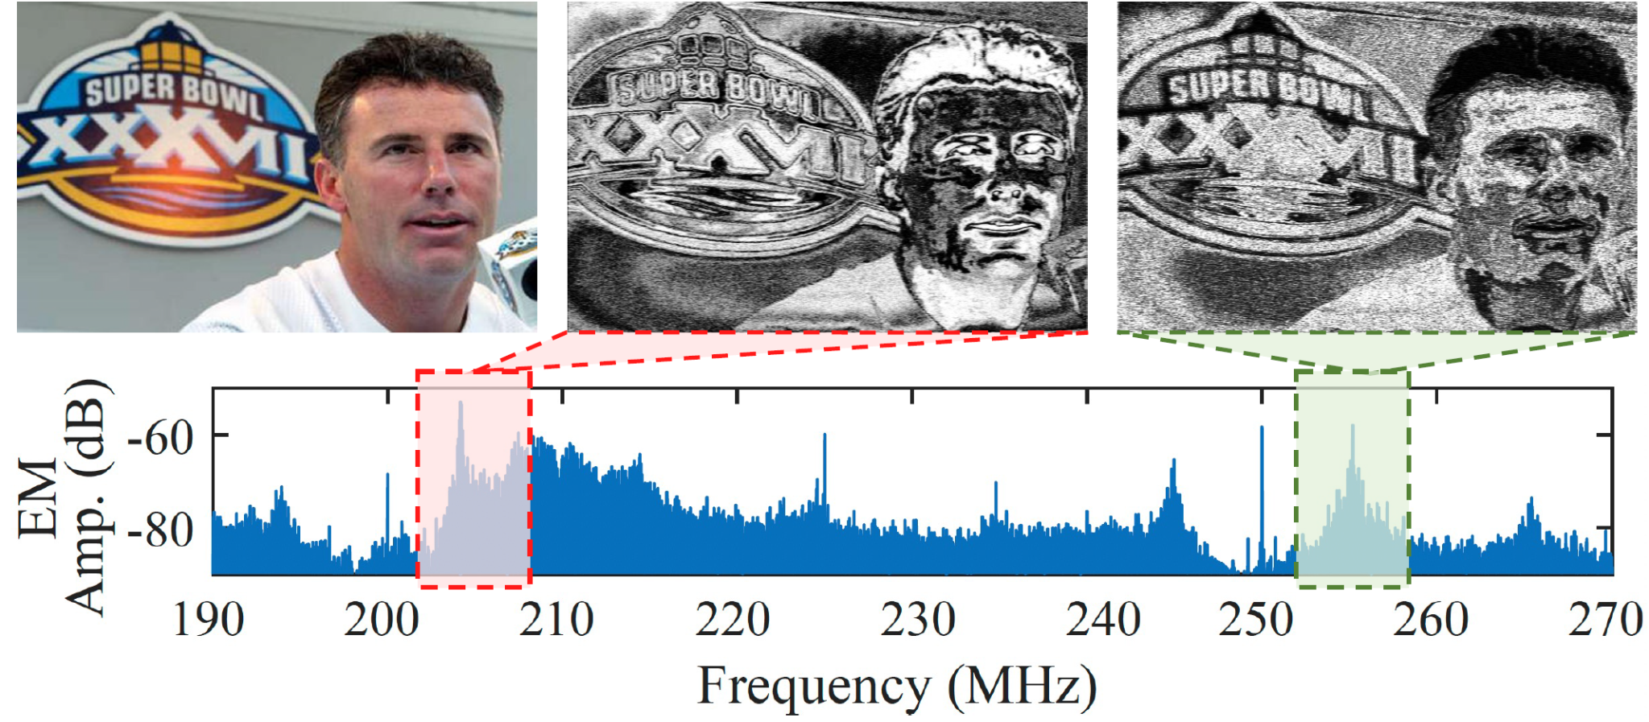
Leakage Modeling: Practical Sampling Distortion
Practical Sampling: ~10 MHz bandwidth (no info of individual bits)
Loss of color
Shuffled gray-scale mapping
Light gradient & high-frequency noise
Frequency dependency
Notes:
A major type of distortions are caused by the fact that most of the time, the adversary can only get an electromagnetic signal bandwidth on the order of 10 MHz in practice. This means that the adversary won’t be able to get the accurate information of the individual bits transmitted over the cables. They can only get a statistical summary of the bits.
And this causes many interesting phenomena. For example, it is only feasible to reconstruct gray-scale images and the colors are all lost, and the gray scales of the reconstruction and the original images are not the same. In addition, you can see high-frequency noises and additional light gradient distortion patterns in the images. Finally, you can also get different information of the original image in different electromagnetic frequency bands.

Slide 13
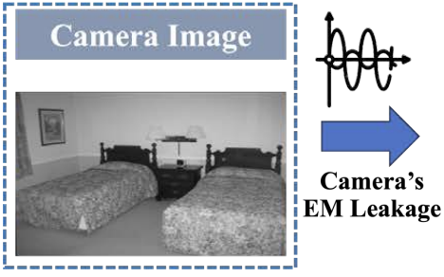
Reconstructions
Response in Freq Band [l, h]
EM Recon in [l, h]
Noise
Interface Protocol
Clock Interference
Notes:
In addition, we observe that the noise and distortion patterns in the reconstructed images are also predictable and well-structured. This means it is possible to build an algorithm to map the noisy reconstructions back to the original image domain.
So we were able to build a signal processing pipeline that combines information from multiple EM frequency bands and uses a image-to-image translation network to acquire high-quality reconstructions of the images.

Slide 14
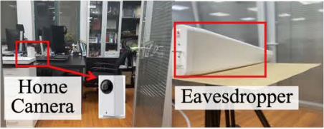
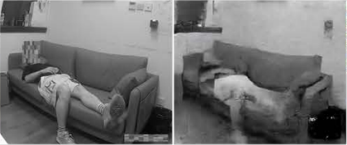
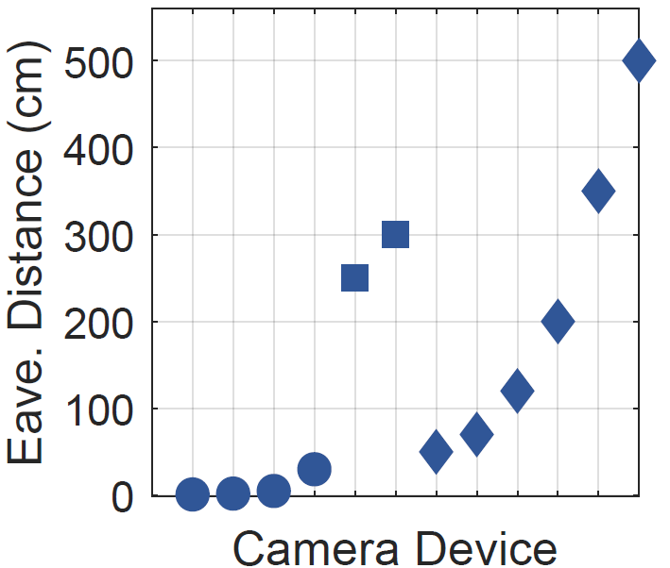
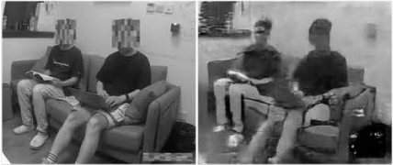
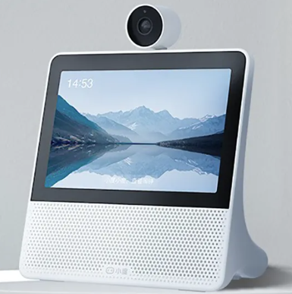
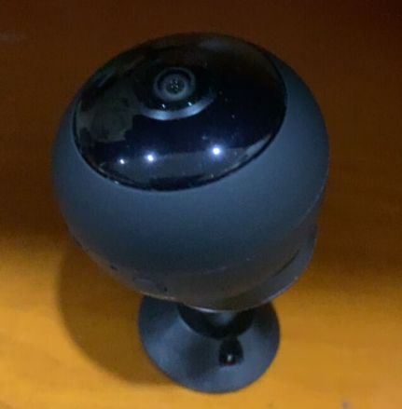
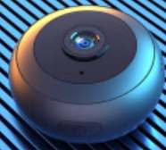
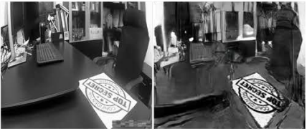
Susceptible Devices: Home Cams
Home Cam (6)
Smart Screen Spy/USB Cam
Notes:
Alright finally, here are some evaluation results. Overall, we tested 12 different commercial devices that have embedded cameras.
And of course, home cameras might be the first thing we think about. We found that this category of cameras actually generate very strong leakage and allow the adversary to eavesdrop on camera data from several meters away, and even through walls and doors in many cases.
It is also worth noting that besides the dedicated IoT smart home cameras that people use for home surveillance, such as baby monitors, the susceptible home cameras also include things like smart screens and USB cameras and even hidden spy cameras that store data locally.

Slide 15
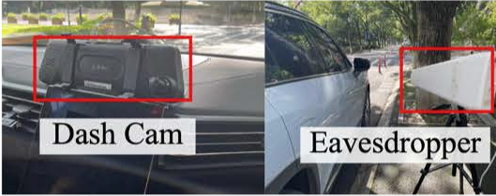
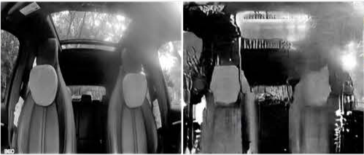
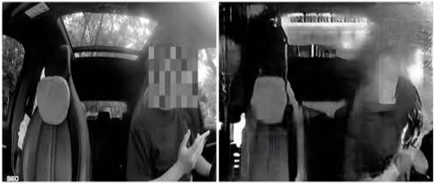
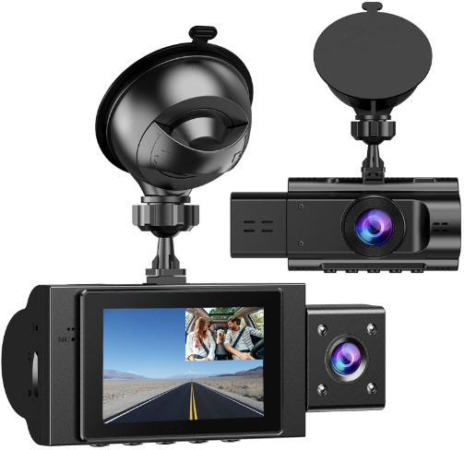
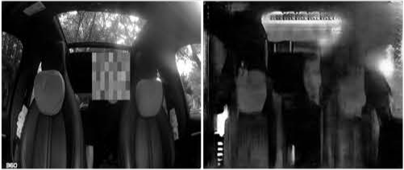
Susceptible Devices: Dash Cams
Dash Cam (2)
Notes:
Besides home cameras which could be the main target of the attacker, we found that dash cams are also susceptible.
For example, many dash cams often have these inward facing camera units that also record the interior of the cars. Using this eavesdropping technique, the dash cams could allow adversaries to tell who are in the car without directly peeking in front of the cars’ windows.

Slide 16
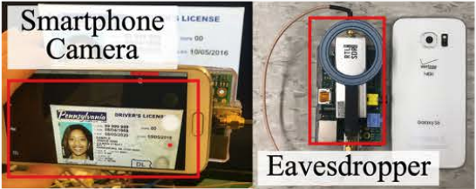
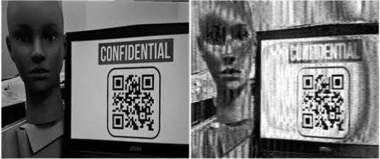
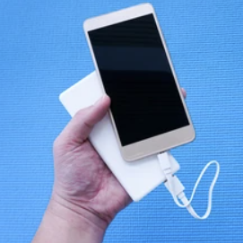
Susceptible Devices: Smartphone Cams
[Photo: Shutterstock]
Smartphone (4)
Notes:
And not surprisingly, we found that our phone cameras also leak.
However, the good news for users is that with our current eavesdropping set up, the eavesdropping distances for smartphones are often pretty small, on the order of several centimeters. The longest distance from which we could get a intelligible image was about 30 cm for a Google Pixel phone.
It is not impossible to eavesdrop at such a short distance. But the attackers do have to be more creative. For example, one potential scenario is to disguise the eavesdropping device as a rental power bank that can get really close to the phones.
Now I believe many people are wondering, what are the factors that could affect the eavesdropping distances? Because if we understand these factors, we can also potential control them to mitigate the data leakage.

Slide 17
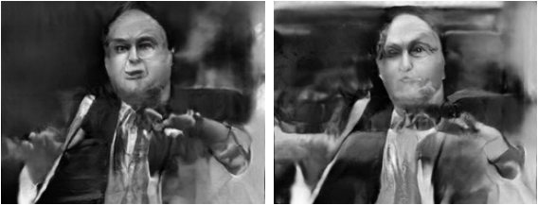
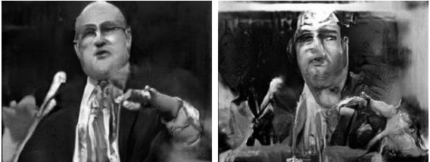
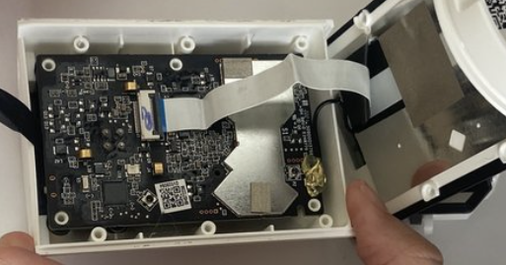
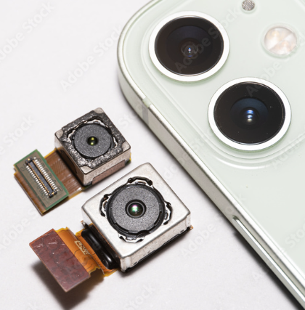
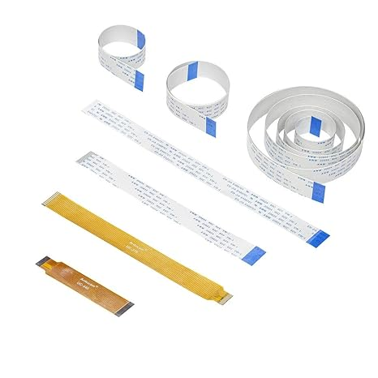
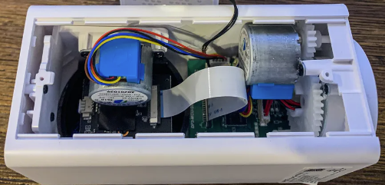
Factors & Mitigation: Shorter Cables, Better Shielding
Reconstruction with Different Cable Length @ Antenna-camera Distance
Reconstruction with Different Cable Shielding Types
[Photo: Adobe Stock ]
Notes:
And some of you might already thought about a physical factor that is the length of the cable.
Because the data transmission cables are acting as unintentional antennas that broadcast the camera data to adversaries, longer cables will generally lead to higher antenna efficiency and thus a stronger leakage.
Our observation is that the home cameras often use very long cables, often to support some interesting form factors such as tunable camera angles that require the camera sensor to be very far away from the processor boards.
And another related factor is the electromagnetic shielding over the transmission cables. Again, we found that home cameras and dash cams often do not apply any shielding to the cables.
In contrast, smartphone cameras often the shortest cables and also the best shielding designs.

Slide 18
Factors & Mitigation: Shorter Cables, Better Shielding
Reconstruction with Different Cable Length @ Antenna-camera Distance
Reconstruction with Different Cable Shielding Types
[Photo: Adobe Stock ]
Notes:
And of course, if you still remember how people are making their own smart security cameras out of Raspberry Pi camera modules, I hope I have convinced you why it is a really bad idea to do this.

Slide 19
Factors & Mitigation: Minimize Bit Transitions
Notes:
And as we mentioned, the electromagnetic leakage from cameras is generated by image-specific bit flips over the data transmission interface.
We found that if the interface designers can improve the way they arrange the order of transmitted bits, for example by grouping the same bits of adjacent pixels together to smooth out many unnecessary bit transitions, they should be able to greatly reduce the level of information leakage.

Slide 20
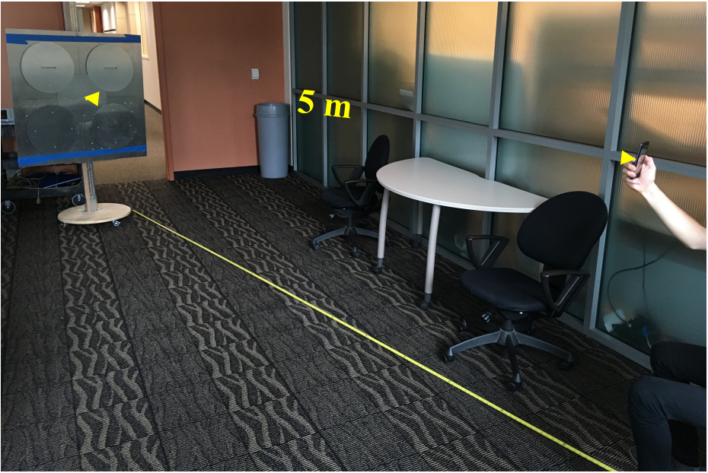
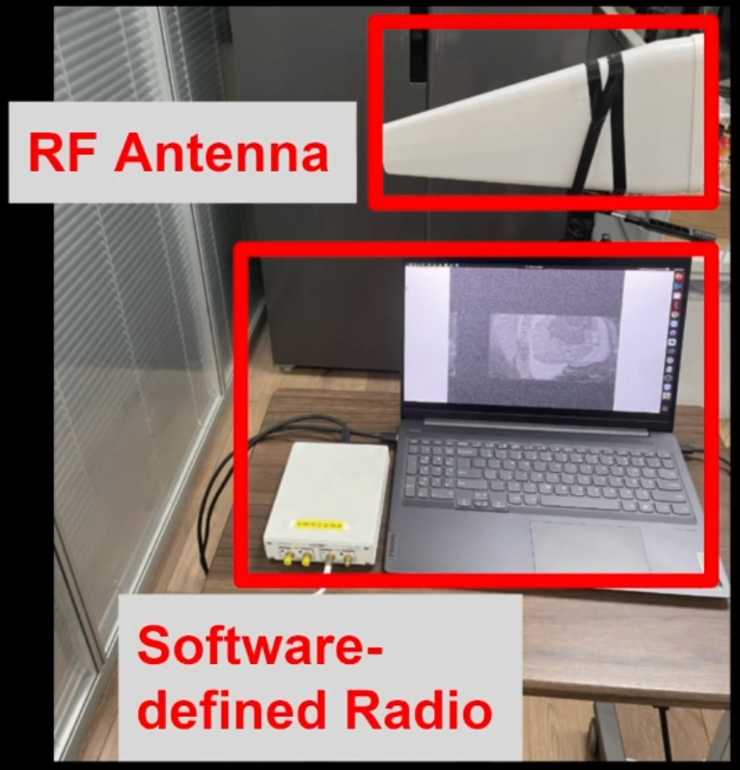
Discussion: Distance
Lab Customized Receiver
COTS Receiver
$15 on Amazon
$30 to $2000
[Yilmaz et al., IEEE MILCOM 2019]
[EM Eye]
Notes:
Ok finally I’d like to discuss a few interesting things for future research.
The eavesdropping distance is definitely the most important factor. In this work we used some COTS devices such as a $15 antenna that you can get on Amazon. And with this set up, for smartphone cameras we could get signals from no more than 50 cm away.
But we found previous work showing that with some lab customized large antennas they could get the smartphone camera signals from over 5 m away which is an increase by about 10 times. So it will be interesting to explore the design space of the eavesdropping equipment to see how the attack distance may be further improved.

Slide 21
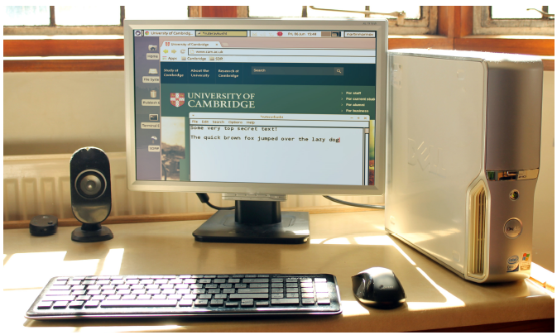
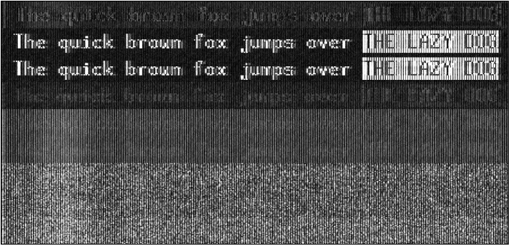
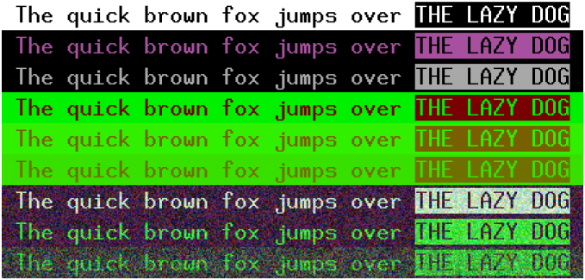
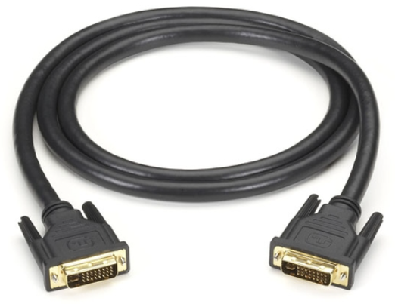
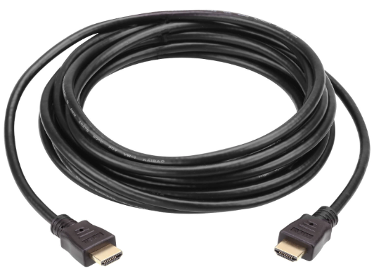
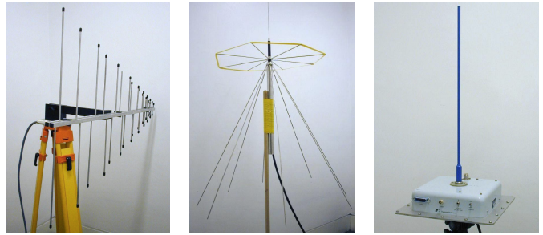
TEMPEST: From Computer Outputs to Inputs
[“Electromagnetic radiation from video display units: An eavesdropping risk?”, Wim Van Eck, 1985]
[“Compromising emanations: eavesdropping risks of computer displays”, Markus Kuhn, 2003]
Notes:
Alright at this point, I believe many of you who are familiar with the research of electromagnetic side channel leakage have already thought about the famous TEMPEST eavesdropping attacks against computer displays.
And if we consider how these display interfaces such as HDMI and DVI transmit the displayed images, we will realize that this eavesdropping attack against embedded cameras are caused by the same fundamental problem that have already existed for over 40 years.
Unfortunately, the semantic gap between how we model our computer systems’ output and input components have kept us from extending our analysis to sensor peripherals until now.

Slide 22
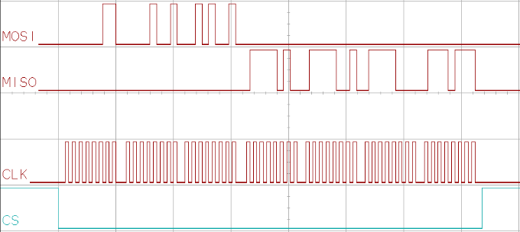
Discussion: Other Sensors & Broader Impact
Other sensors and interfaces: SPI, I2C, ……
[Photo: Adafruit]
Notes:
So in the future, we are expecting there should be more research investigating such electromagnetic side channel leakage problems in the sensing components of emerging cyber-physical systems.
For example, our ongoing research finds that the same information leakage also happens on fingerprint sensors which allows adversaries to eavesdrop on users’ biometrics.
So it remains an impactful research direction to further analyze the susceptibility of other types of sensor systems.

Slide 23
Summary
EM leakage from cameras allows reconstructing image streams.
Better not DIY your own home security cameras……
A new chapter of TEMPEST in sensors!
Team
https://emeyeattack.github.io/Website/
Yan Long
Qinhong Jiang
Chen Yan
Tobias Alam
Xiaoyu Ji
Wenyuan Xu Kevin Fu
Notes:
So that concludes my talk. Don’t forget to take a photo of the QR code so you can access the open source codes online.
I am happy to take any questions you may have.

Slide 25
Color
Notes:
I would like to start with a question. Have you ever felt the vibration of the electronic speakers around you when they are generating sounds? Take the scenario depicted in the picture as an example. If our hands are on the same table with a playing speaker, we often feel the vibrations from the speaker through the mechanical structures in contact with it.
But why does sound generate such vibrations?

Slide 26
Angle
Notes:
I would like to start with a question. Have you ever felt the vibration of the electronic speakers around you when they are generating sounds? Take the scenario depicted in the picture as an example. If our hands are on the same table with a playing speaker, we often feel the vibrations from the speaker through the mechanical structures in contact with it.
But why does sound generate such vibrations?

Slide 27
Analog Filtering
Notes:
I would like to start with a question. Have you ever felt the vibration of the electronic speakers around you when they are generating sounds? Take the scenario depicted in the picture as an example. If our hands are on the same table with a playing speaker, we often feel the vibrations from the speaker through the mechanical structures in contact with it.
But why does sound generate such vibrations?

Slide 28
Leakage Modeling: Multi-wire Signal Polarity Inversion
Notes:
For example, a very interesting phenomena we observed is that when we move the antenna around the target camera, we see varying brightness in the reconstructed images.
In some cases, we can even observe a complete inversion of the reconstruction’s grayscale, as shown here.

Slide 29
Leakage Modeling: Multi-wire Signal Polarity Inversion
Position 1
Data-only Recon (Id)
Clock-only Recon (Ic)
position 2
Position 2
Ic - Id
Position 1 Recon
Position 2 Recon
Notes:
Again, through many experiments of hypothesis testing, we found that this phenomenon is caused by the multi-wire structure of the camera data transmission interface, as shown in the left, you would have both data lines and clock lines, and sometimes even multiple data lines depending on the actual protocol the camera uses.
[explain the examples]

Slide 30
Discussion: Encoded Image Transmission
Simple FFT-LDA (spectral) features
>90% accuracy recognizing 100 scenes
Frequency (MHz)
Notes:
In addition, this work investigated a camera data interface that transmits uncompressed RAW camera data, which is widely used on embedded cameras.
But there do exist cameras that transmit encoded data. Our preliminary experiments find that their electromagnetic leakage are still highly correlated with the captured images, meaning that the image could be inferred using some simple machine learning algorithms.

