Slide 1
Architectures for Secure Quantum Computing Systems
Prof. Jakub Szefer
Computer Architecture and Security Lab – CASLAB
Dept. of Electrical Engineering
and Dept. of Computer Science (by courtesy)
Yale University
https://caslab.io/jakub

Slide 2
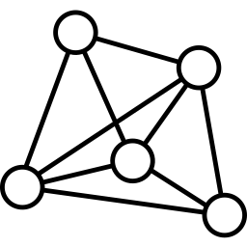
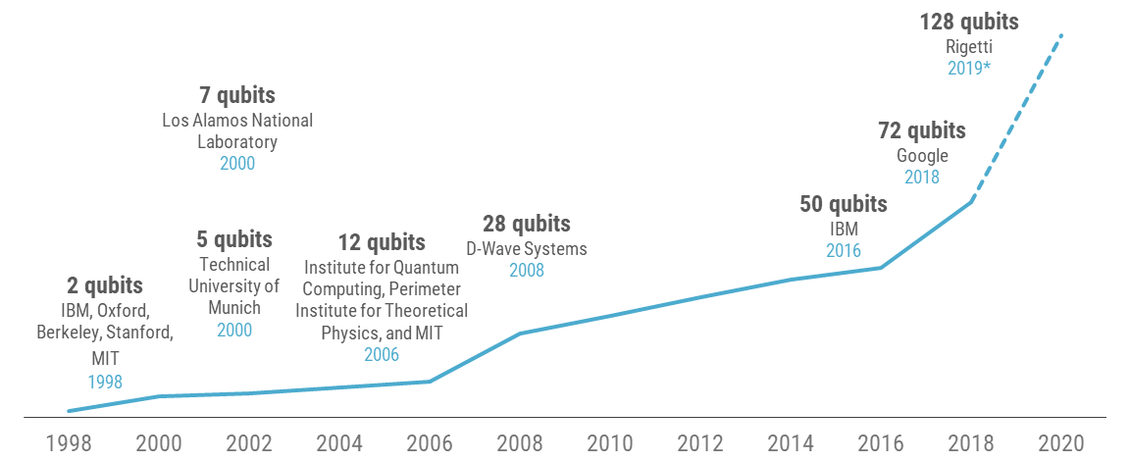
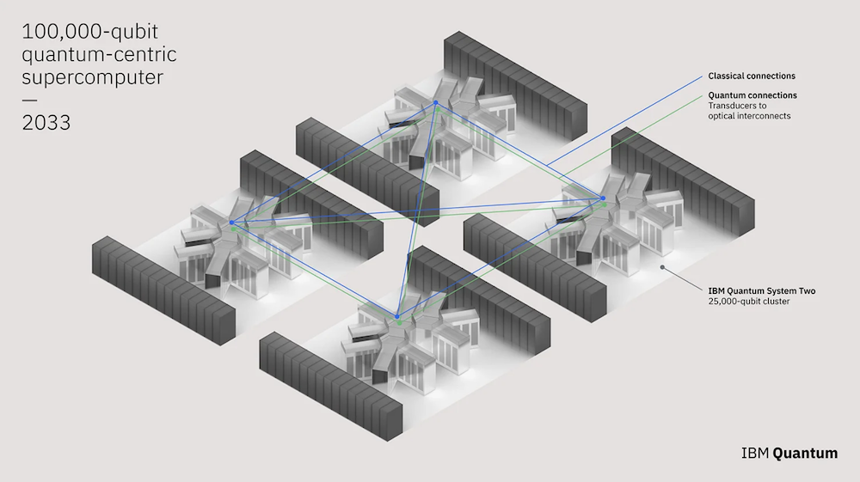
Quantum Computing Today
$
The field of quantum computing is undergoing rapid development
Quantum computers are in infancy, but holds potential in that they could solve complex problems
Promise advances in life-saving drugs, green-battery technology, etc.
They will process or store valuable intellectual property
Quantum computers are already cloud-based
Remote users can access them easily
But open to attack by malicious users
Further threats of untrusted cloud providers
Need to analyze and secure quantum computer architectures today
IBM Quantum
Cloud
Providers
4159 qubits
IBM projection
2025
Amazon Braket
Microsoft Azure
433 qubits
IBM
Nov. 2022
May 2023 announcement of 100,000 qubit computer for 2033
… 2022
… 2025
… 2033

Slide 3
Architectures for Secure Quantum Computing Systems

Slide 4
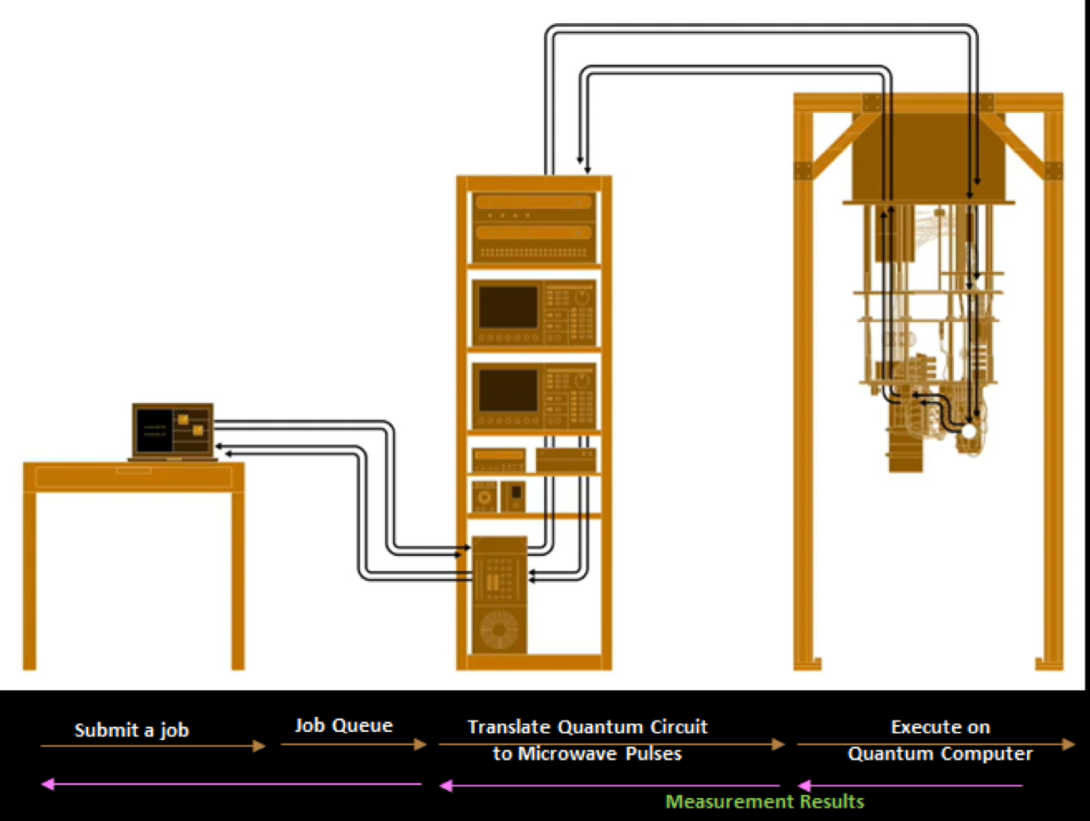
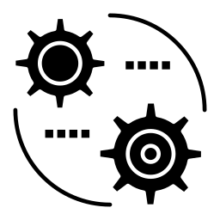
Typical Quantum Computer System Overview
Cloud-based Access
Analog RF Pulses
Network Packets
Classical Co-processor
Network Packets
Digital Signals
User
Digital Signals
Quantum Program
Quantum Program Compiler
Management Server
Quantum Computer Controllers
Quantum
Processing
Unit

Slide 5
Typical Quantum Computer System Overview
Abstract view of the quantum computer system can aid in analyzing the potential security threats:
What are threats and possible protections at each ?
DAC / ADC
CPU
CPU
Digital
Signals
Cloud
User
Digital
Signals
Digital
Signals
Analog
Signals
Solution: classical encryption methods
Solution: classical encryption methods

Slide 6
Assumptions and Threats
Assume honest-but-curious attackers
Do not inject errors or manipulate signals
Only eavesdrop on operation of the quantum computer and any signals
Resulting attack surface:
Cloud (CPU)
Controller (CPU)
Controller (DAC)
QPU
DAC / ADC
CPU
CPU
Digital
Signals
Cloud
User
Analog
Signals

Slide 7
QC-TEE: An Architecture for Trusted QPU

Slide 8
Quantum Computer Trusted Execution Environment
Theodoros Trochatos, Chuanqi Xu, Sanjay Deshpande, Yao Lu, Yongshan Ding, and Jakub Szefer, “A Quantum Computer Trusted Execution Environment,” Computer Architecture Letters (CAL), 2023. Best of CAL Selection (to be presented at HPCA 2024).
Demonstrate how introduction of trusted components in the QPU can help protect from malicious cloud providers
Inspired by trusted hardware in classical computers
Trade improved security for extra hardware and trust in manufacturer
Added features in the QPU can help hide circuits executing on the QPU
No need for blind quantum computation
Simple logic to be added into QPU
DAC / ADC
CPU
CPU
Digital
Signals
Cloud
User
Digital
Signals
Digital
Signals
Analog
Signals

Slide 9
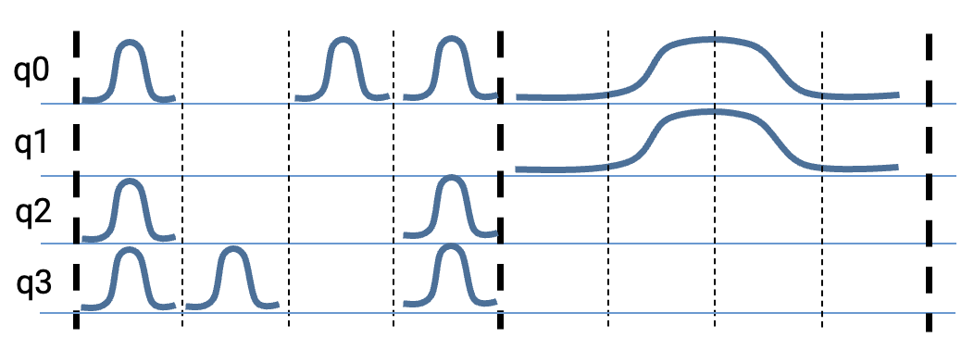
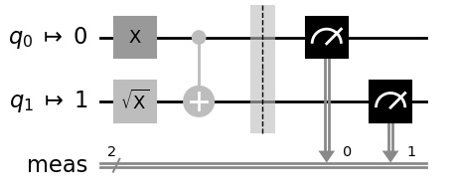
Remote Execution of Quantum Circuits
Users submit circuits that are processed by the cloud provider, and eventually issued to quantum computer controller for execution on the quantum computer
Cloud-based Access
Analog RF Pulses
Network Packets
Classical Co-processor
Network Packets
Digital Signals
User
Digital
Signals
Quantum Program
Quantum Program Compiler
Management Server
Quantum Computer Controllers
Quantum
Processing
Unit

Slide 10
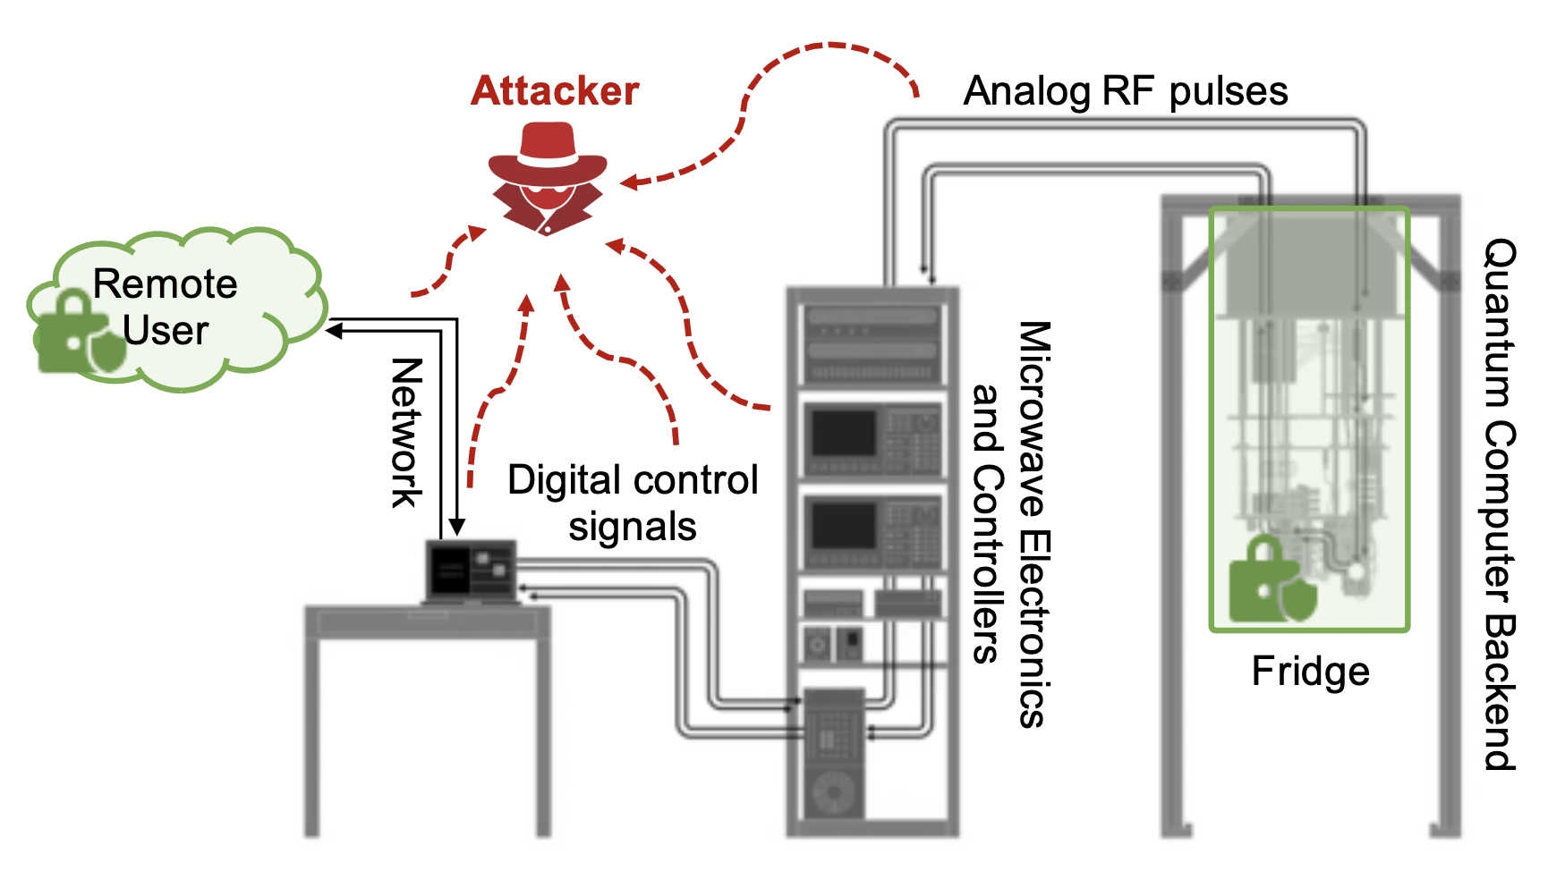
QC-TEE Assumptions
Focus on superconducting qubit quantum computers
Fridge of superconducting qubit quantum computers can form natural trust boundary
Temperature and pressure changes can be easily detected when fridge is opened
Key idea: need to protect or obfuscate the analog RF pulses going into the (trusted) QPU

Slide 11
High-Level Idea of Hiding Control Pulses
Analog control pulses cannot be ”encrypted” unlike digital information, but we can hide or obfuscate them instead
Input user circuit:
Circuit with decoy pulses:
Decoy pulses attenuated in the QPU
q0
q1
q2
q3
q0
q1
q2
q3
q0
q1
q2
q3

Slide 12
Trusted Hardware for Attenuation of Control Pulses
q0: 0 1 0 0 0 0 0 0
q1: 1 1 1 1 0 0 0 0
q2: 0 1 1 0 1 1 1 1
q3: 0 0 1 0 1 1 1 1
q0
q1
q2
Input RF Pulses
Encrypted Input Bitmap
Load Bitmap
Trigger Start
Encrypted output bitmap sent to user
q3
Decryption Engine
Encryption
Engine
QC-TEE
Switch Control Module
Input Bitmap Mem.
TRNG
Attenuation Switches
Digital signals
To Qubits
RF pulses
q0
q1
q2
q3

Slide 13
End-to-End Operation
Software needs to generate the decoy pulses and the bitmap, while hardware attenuates the pulses in side the fridge:
Generate Control Pulses for User’s Circuit
Mix Control Pulses with Decoy Pulses
Generate Input Bitmap
Encrypt Input Bitmap using AES-GCM and shared secret key which is generated using PQC-KEM and Public Key of the Backend
Send Transpiled Circuit including Mixed Decoy Pulses
Send Encrypted, Signed Input Bitmap
Decrypt Input Bitmap using AES-GCM and shared secret key generated in step 4
De-Mix Decoy Pulses
Execute Circuit
Input User
Quantum Circuit
H
Modified Compiler
(e.g. part of Qiskit)
Runtime
(e.g. part of Qiskit)
Quantum
Computer Manager
X
Remote User
Quantum Computer Provider

Slide 14
Evaluation Setup
q0
q1
We evaluated different configurations:
Baseline
One-sixteenth-delay
Quarter-delay
Max-delay
Further for all the levels, except baseline, we analyze results with and without a randomize-output option
Evaluated on:
7-qubit IBM Perth, to test small-scale benchmarks
27-qubit IBM Algiers, through the Pay-As-You-Go plan on IBM Cloud to test medium-scale benchmarks
Aer simulator
q2
q3
Quarter-delay vs. Max-delay example
q0
q1
q2
q3

Slide 15
Evaluation Using Variational Distance
Worst case Variational Distance (VD) for the QASM-Bench benchmarks considering perfect RF switches and emulating imperfect RF switches (99.99% amplitude attenuation)
Worst case Variational Distance (VD) for the QASM-Bench benchmarks for machines with different Quantum Volume (QV)

Slide 16
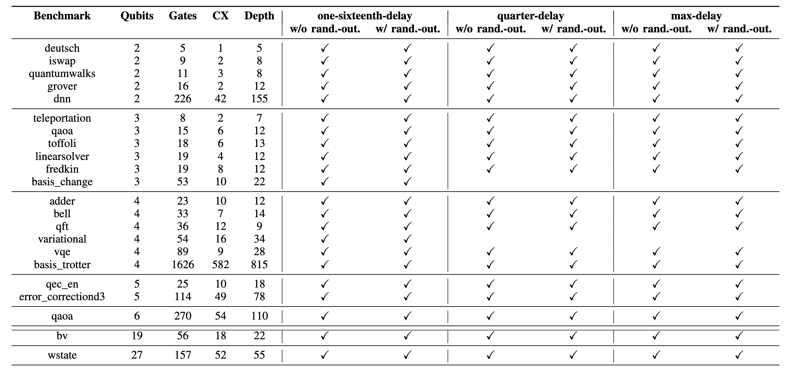
Evaluation of Benchmark Correctness
Evaluation of correctness of 22 QASM-Bench benchmarks assuming imperfect RF switches (99.99% amplitude attenuation), all benchmarks show correct results

Slide 17
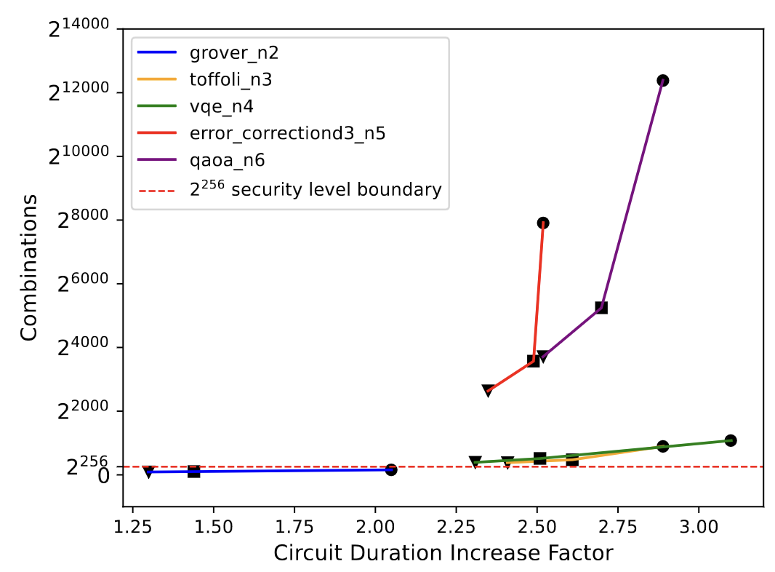
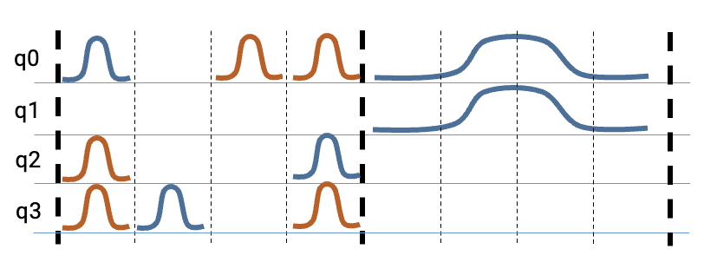
Security Analysis
The cloud provider is able to see all the (real and decoy) control pulses, but needs to figure out which ones are real and which are decoy
The complexity based on our analysis:
Number of possibilities is much beyond 2²⁵⁶ combinations that cloud provider would have have to consider

Slide 18
Open Challenges in Securing Quantum Computer Architectures
Developed first architecture for securing quantum computation in the cloud
Still, many unexplored configurations still need to be studied
Analyze tradeoffs between cost and security protections
Develop different threat models and use-cases
Cloud (CPU) | Controller (CPU) | Controller (DAC) | QPU
Untrusted | Untrusted | Untrusted | Untrusted
Untrusted | Untrusted | Untrusted | Trusted
Untrusted | Untrusted | Trusted | Untrusted
Untrusted | Untrusted | Trusted | Trusted
Untrusted | Trusted | Untrusted | Untrusted
Untrusted | Trusted | Untrusted | Trusted
Untrusted | Trusted | Trusted | Untrusted
Untrusted | Trusted | Trusted | Trusted
Cloud (CPU) | Controller (CPU) | Controller (DAC) | QPU
Trusted | Untrusted | Untrusted | Untrusted
Trusted | Untrusted | Untrusted | Trusted
Trusted | Untrusted | Trusted | Untrusted
Trusted | Untrusted | Trusted | Trusted
Trusted | Trusted | Untrusted | Untrusted
Trusted | Trusted | Untrusted | Trusted
Trusted | Trusted | Trusted | Untrusted
Trusted | Trusted | Trusted | Trusted
DAC / ADC
CPU
CPU
Digital
Signals
Cloud
User
Digital
Signals
Digital
Signals
Analog
Signals

Slide 19
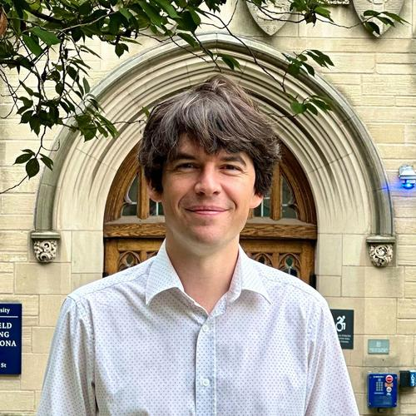
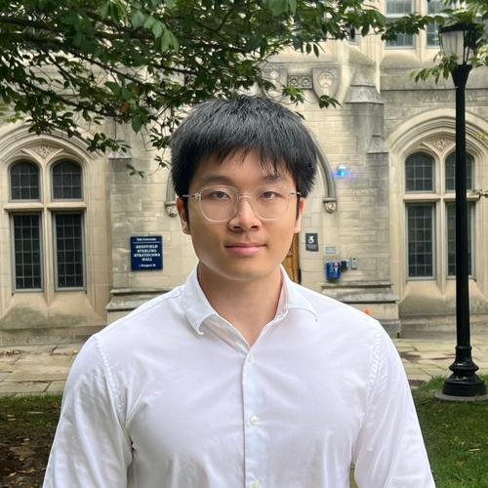
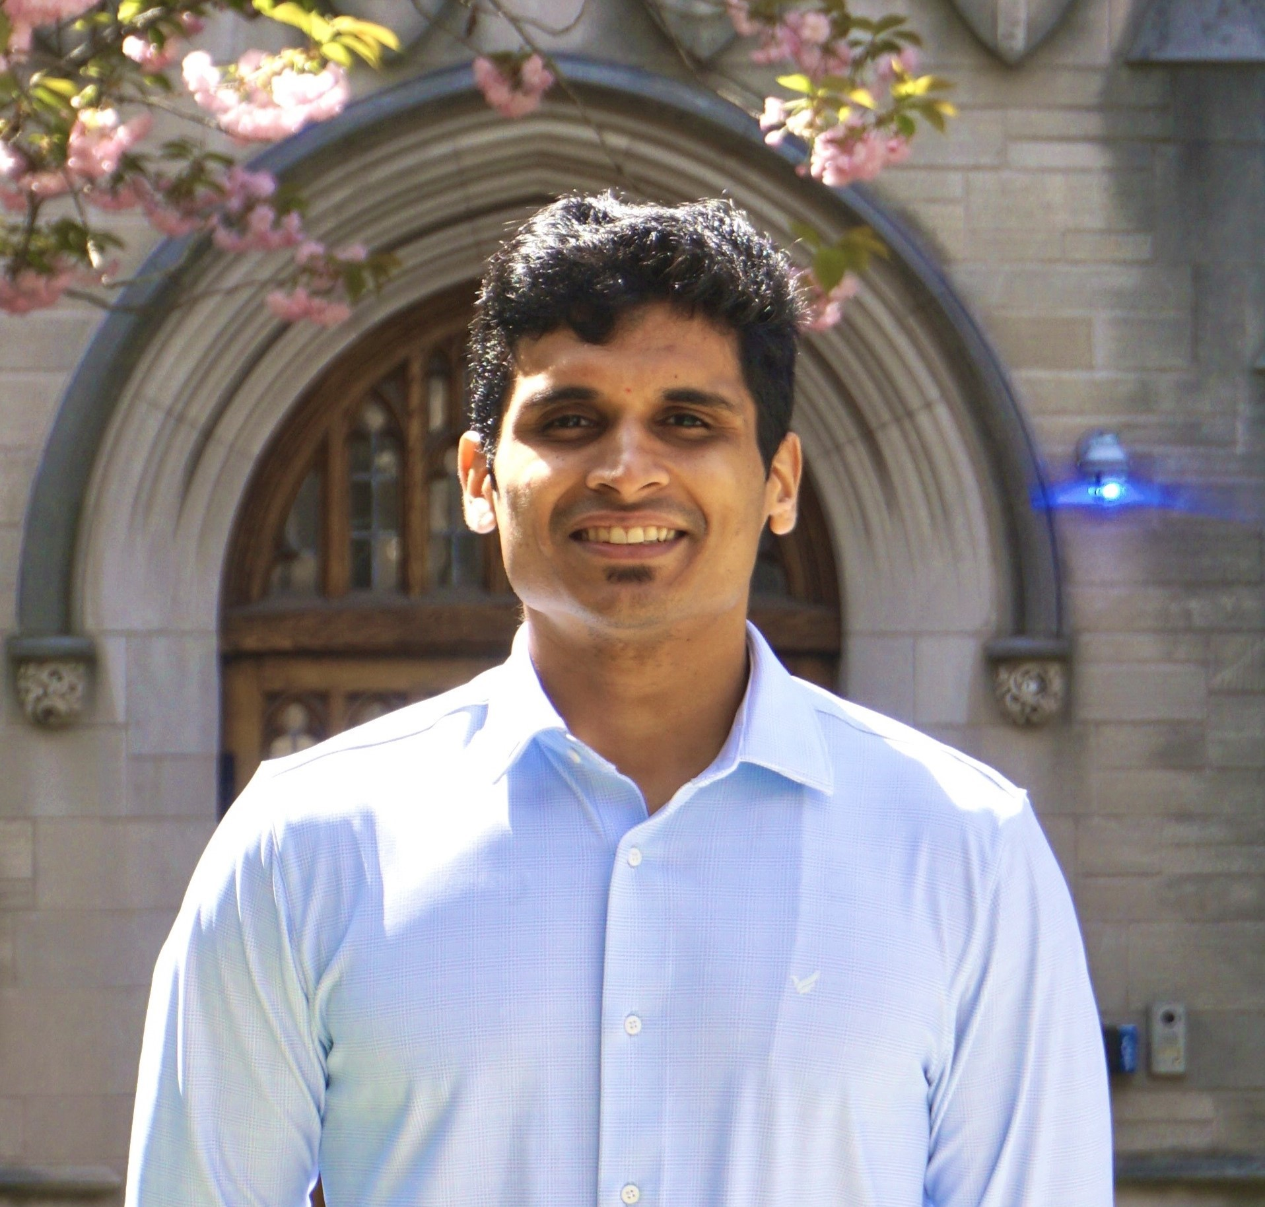
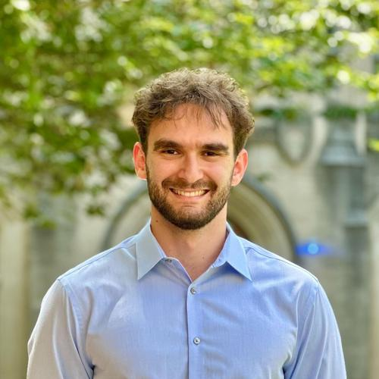
Thank You!
Prof. Jakub
Szefer
Chuanqi
Xu
Sanjay
Deshpande
Theodoros
Trochatos
https://caslab.io/jakub

